Slide 1
Container Standardization A Look Forward
April 26-27, 2013
Dick Schnacke
VP, TransCore
and Chairman, ISO TC104

Slide 2
Happy Birthday, BIC
You look pretty good
(for 80 year olds)

Slide 3
Not as Good-Looking as You Used to Be
(But then, who is?)

Slide 4
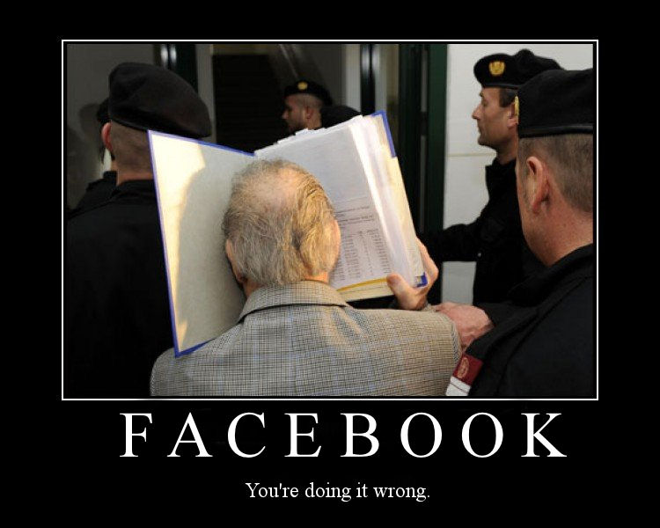
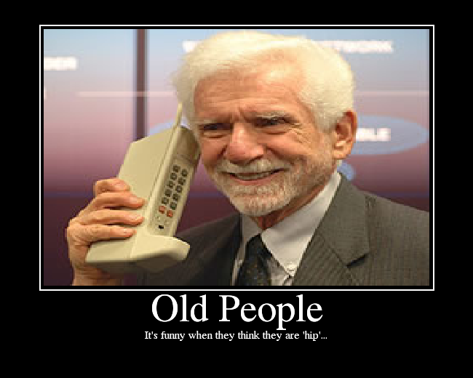
But You Know The Modern Stuff
FACEBOOK
Am I Doing This Right?
SMARTPHONE
I Can’t Ever Get BIC on This Thing!

Slide 5
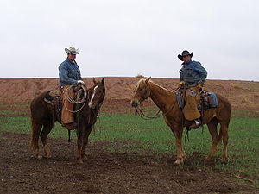
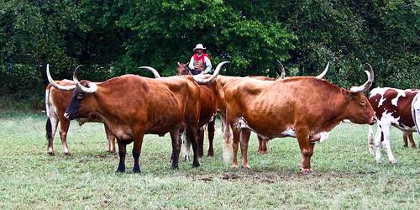
I’m From Texas – Things Are Different

Slide 6
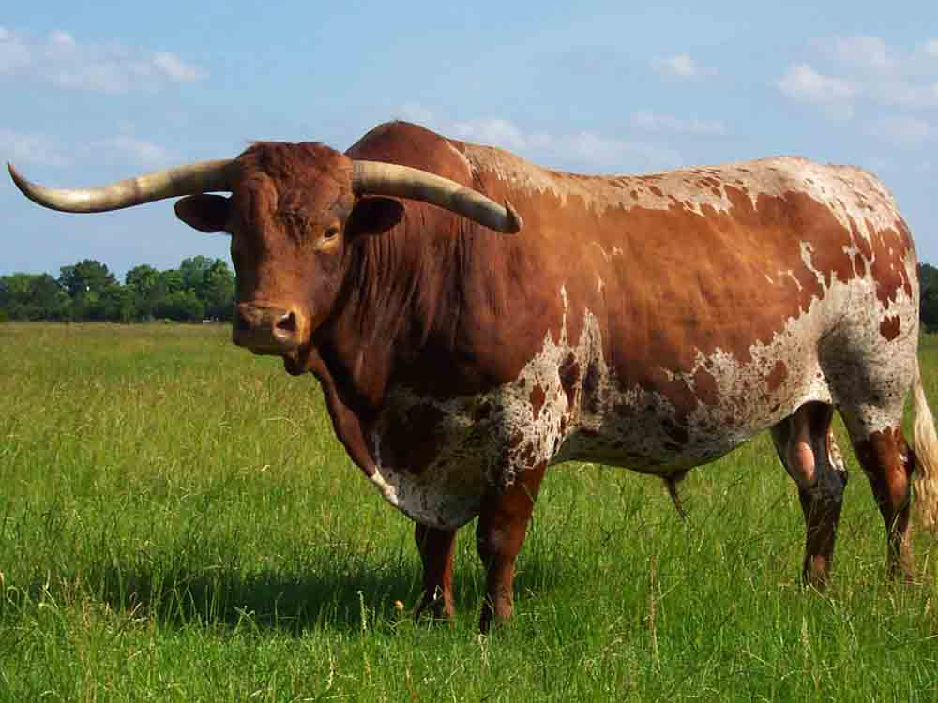
Many Good Texas Truths…..

Slide 7
Every Good Presentation Has…..
Two Good Points….

Slide 8
Every Good Presentation Has…..
…with a Lot of Bull in Between

Slide 9
Why ISO TC104?
We Serve the Container Industry
Serve as a forum to discuss – and ultimately agree on – everything related to containers and container-related equipment
Produce documents that precisely describe the agreed results

Slide 10
Standards Are Good Things
Something to point at
Something to procure to

Slide 11
Past & Future Standardization
Past TC104 activities were highly successful (as Mike Bohlman has summarized)
Expect interesting things in all parts of TC104
But looking forward is harder
Look at the organization and take the pieces one by one

Slide 12
TC104 Organization TC104 = Freight Containers
SC1 = General Purpose Containers
WG1 = General Cargo Containers
WG2 = Handling and Securing
JWG3 = Container Straddle Carriers (with TC110/SC2)
SC2 = Specific Purpose Containers
WG1 = Thermal Containers
WG4 = Tank Containers
SC4 = Identification and Communication
WG1 = Coding, Identification & Marking
WG2 = AEI for Containers & Related Equipment
WG3 = Communication & Terminology
WG8 = Mechanical Seals

Slide 13
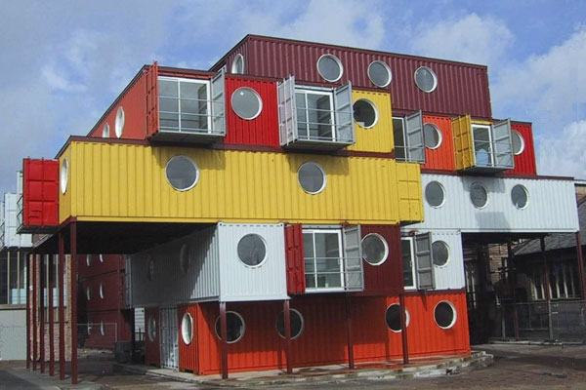
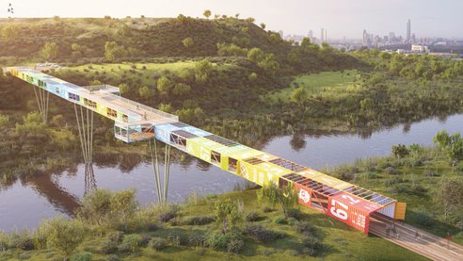
TC104 Subcommittee 1 - General Purpose Containers
WG1 = General Cargo Containers

Slide 14
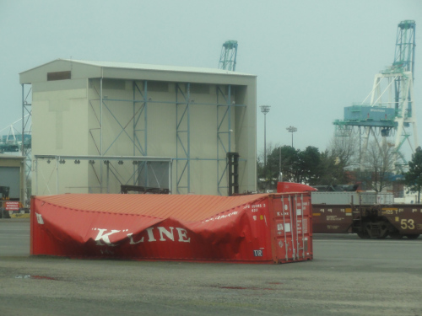
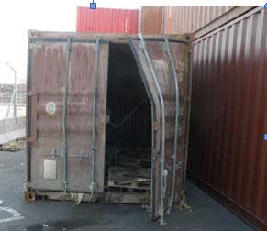
Strength, Integrity & Common Dimensions
Uniformity is not accidental
Usage – and loads – are changeable
Containers have changed before
Will they again?

Slide 15
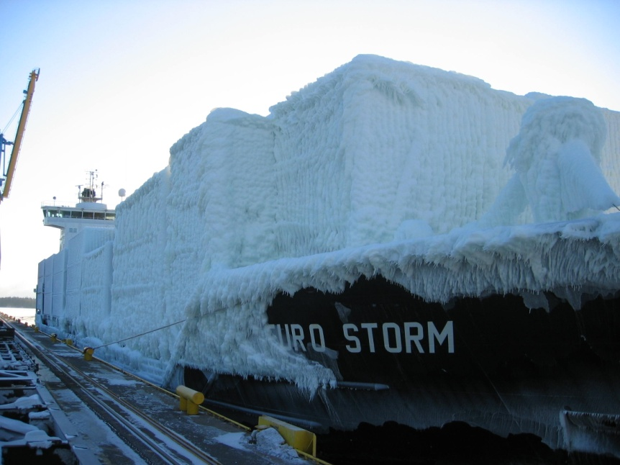
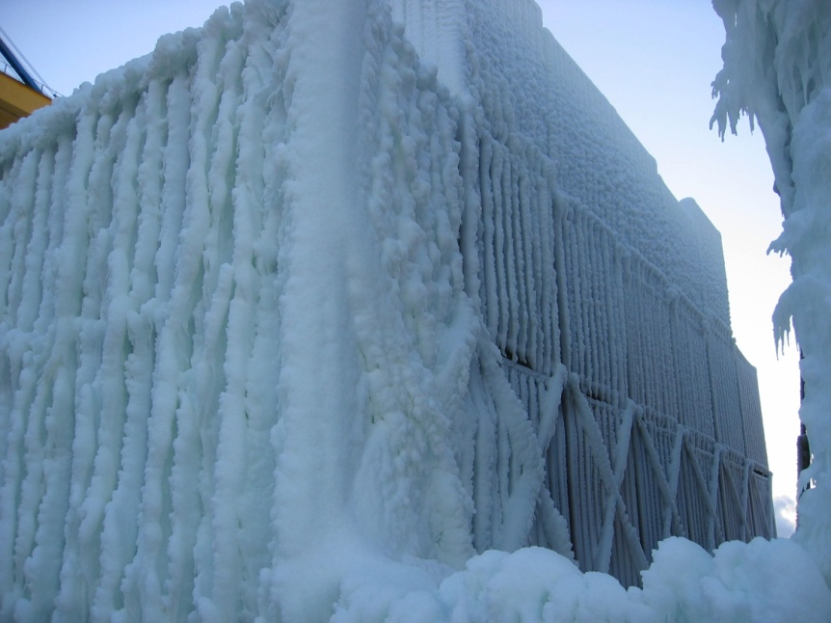
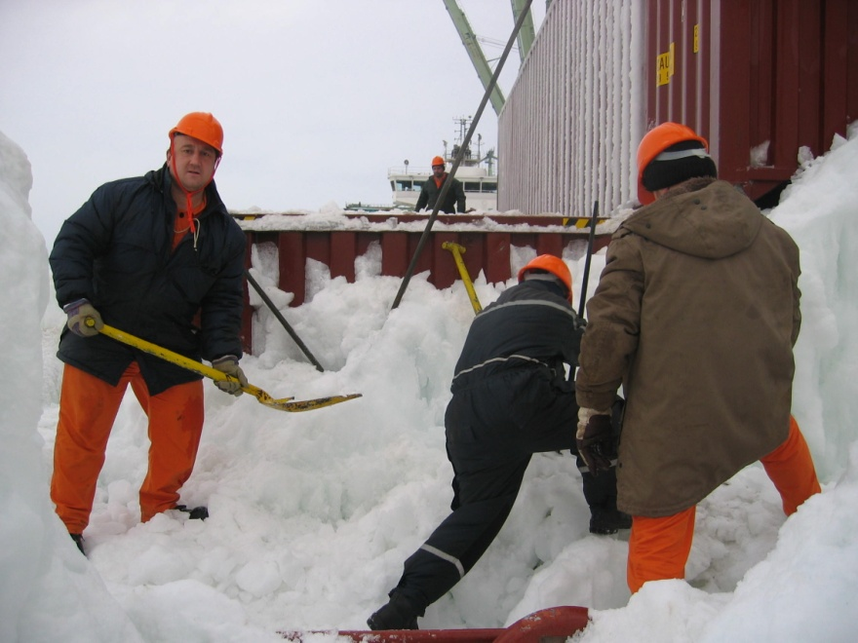
Operations in Extreme Conditions
Things should work –
No matter what

Slide 16
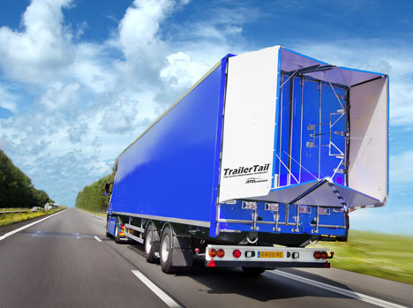
Creative Modifications
Do we care?

Slide 17
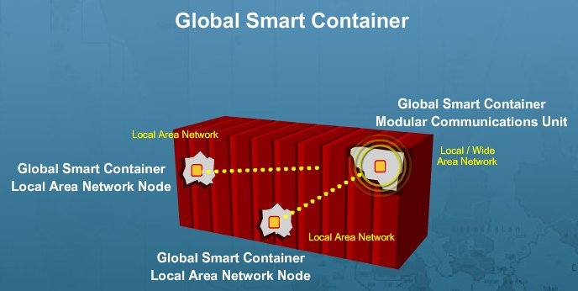
New Materials & Capabilities
Use of non-metals
Strength & durability
Embedded systems & devices
Effects on ‘everything else’

Slide 18
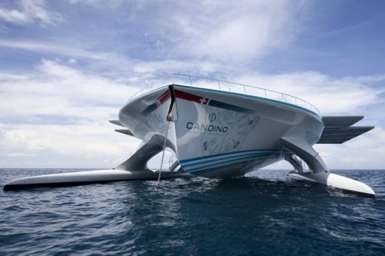
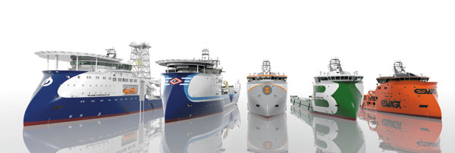
Carriage on New Ships?
Who knows what’s next?

Slide 19
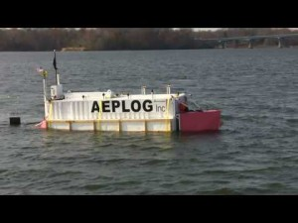
Or Maybe Without the Ship?
What is it?

Slide 20
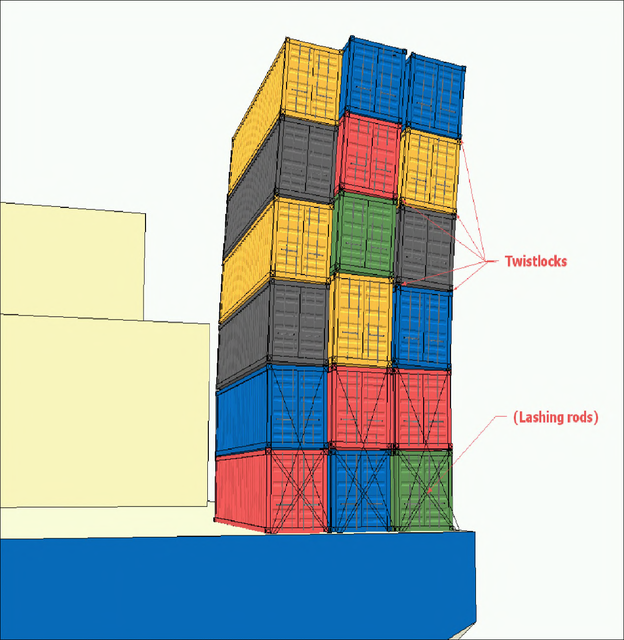
TC104 Subcommittee 1 - General Purpose Containers
WG2 = Handling and Securing
Stabilization – Is
there such a thing as
good enough?

Slide 21
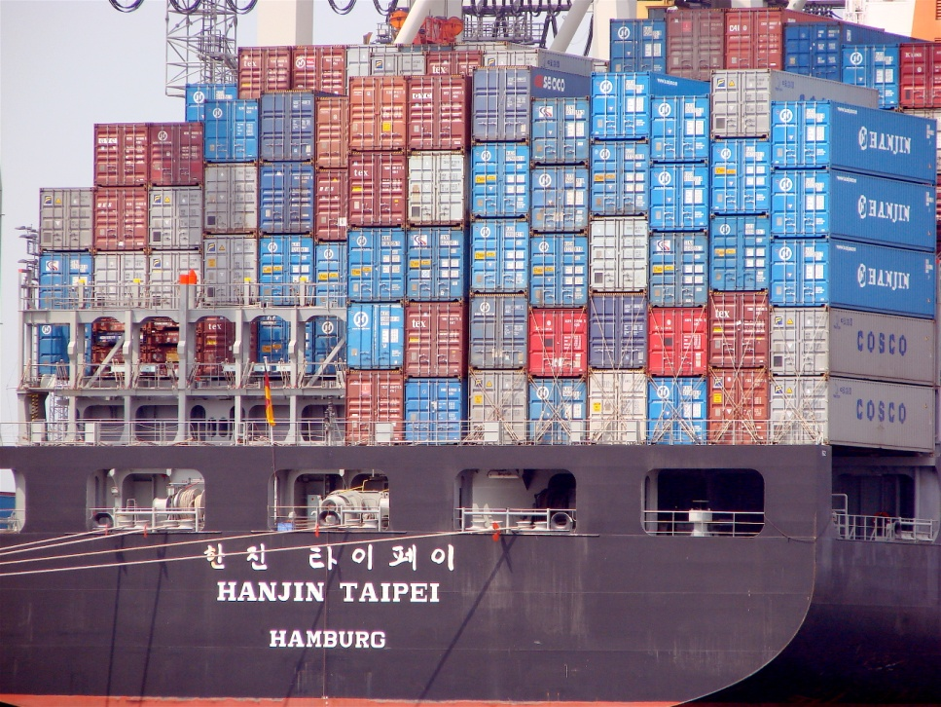
Good

Slide 22
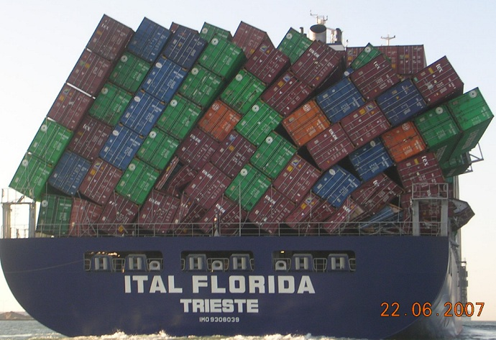
Bad

Slide 23
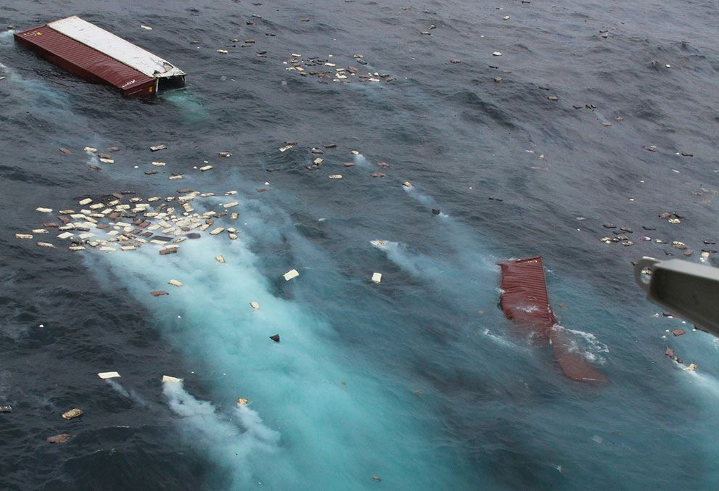
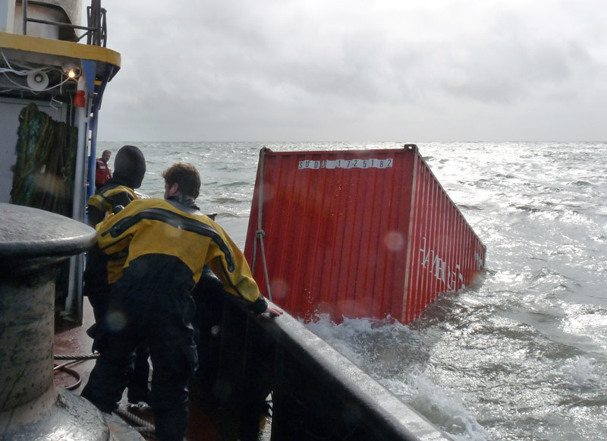
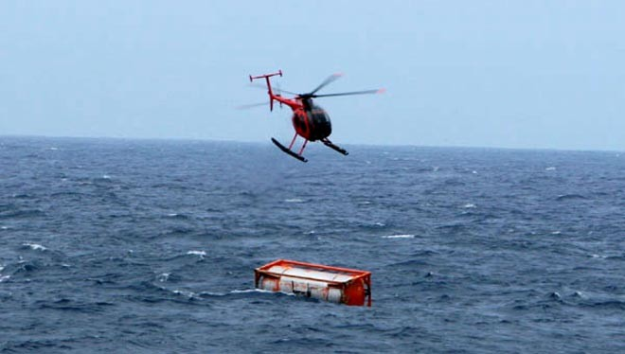
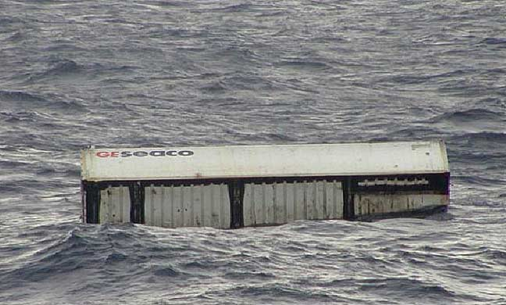
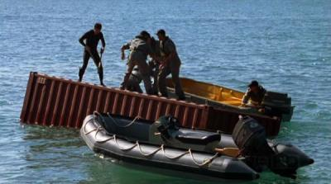
Really Bad
First bullet of copy
Recent: IMO has asked TC104 to investigate

Slide 24
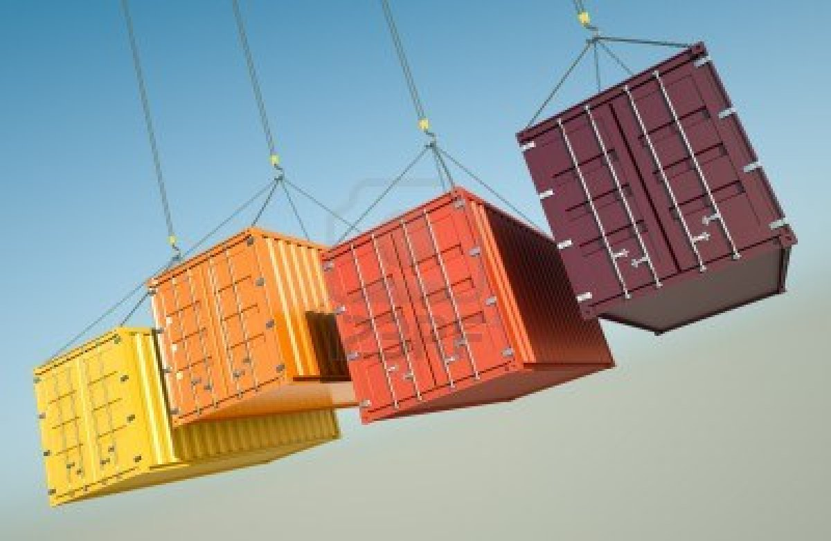
Creative Lifting
Yipes!

Slide 25
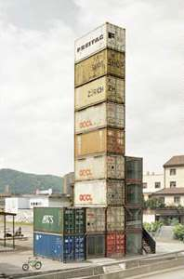
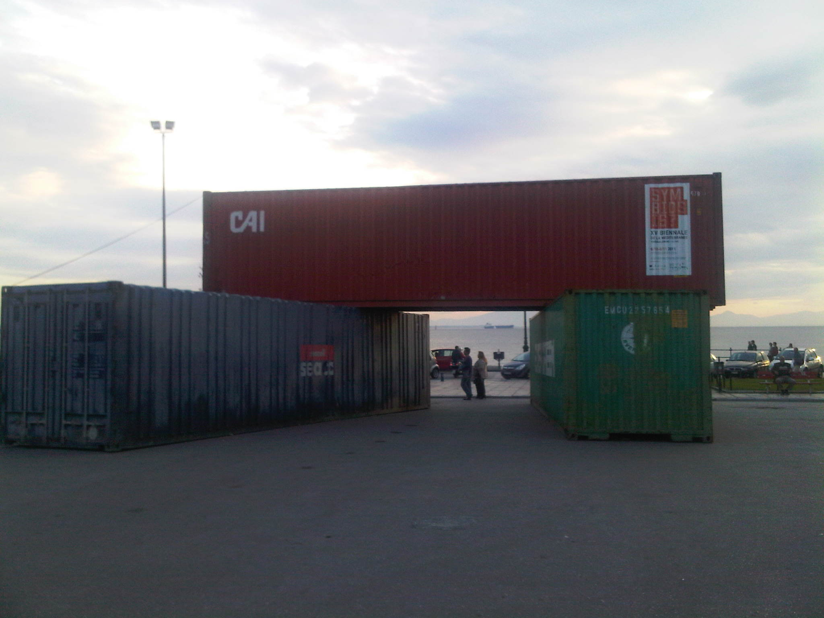
Creative stacking
Is this for real?

Slide 26
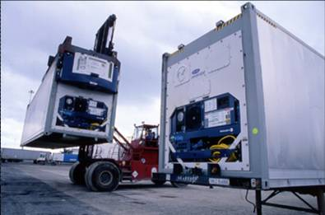
TC104 Subcommittee 2 - Specific Purpose Containers
WG1 = Thermal Containers

Slide 27
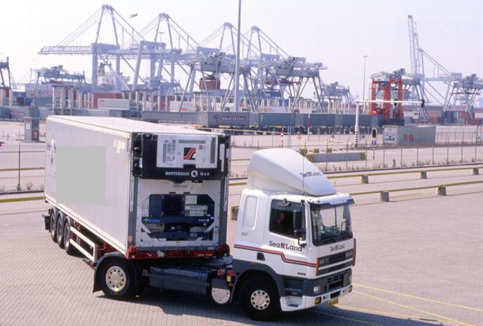
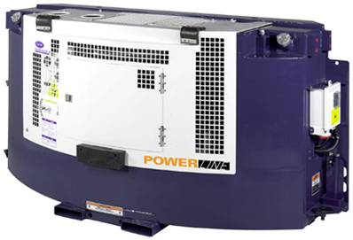
Technology Always Changes
Even refrigeration is evolving!
Who knew?
Will containers be affected?
Alternative fuels, power needs, sizes, etc

Slide 28
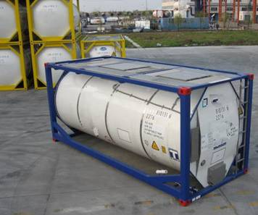
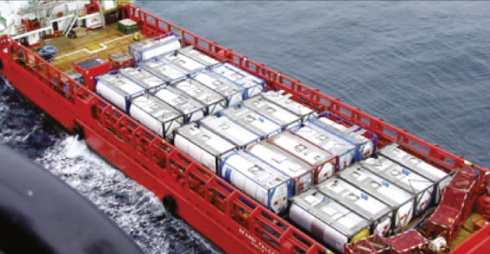
TC104 Subcommittee 2 - Specific Purpose Containers
WG4 = Tank Containers

Slide 29
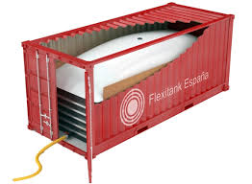
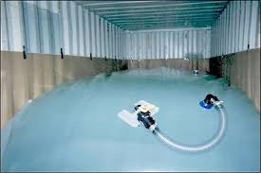
FlexiTanks – Standards Coming
Problems for shippers and carriers
Container Owners Association has tasked BSI to produce a PAS (Publicly Available Specification)
Probably coming to TC104 next

Slide 30
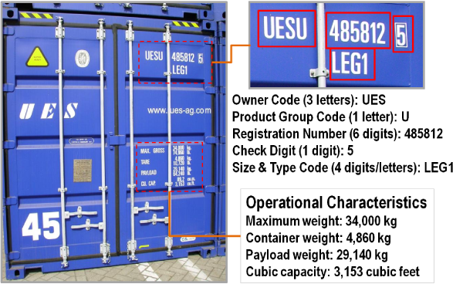
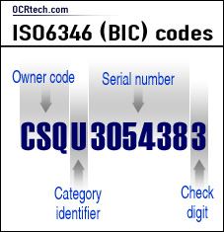
TC104 Subcommittee 4 - Identification & Communication
WG1 = Coding, Identification & Marking
(Visual) ID

Slide 31
What’s Ahead for Identification/Markings?
Unique markings related to strength?
Unique markings related to ‘green’?
Unique markings related to unique box capabilities (built-in systems & devices)?
Other?

Slide 32
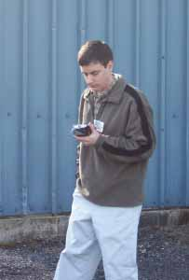
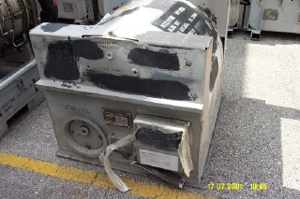
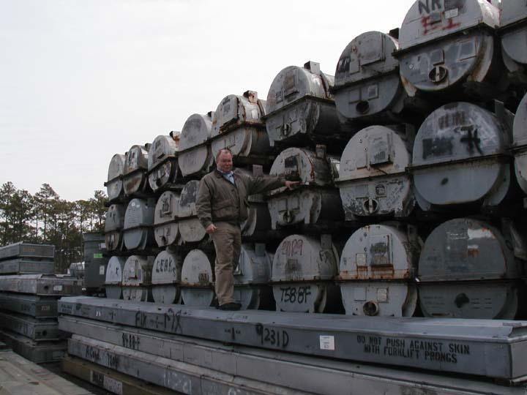
TC104 Subcommittee 4 - Identification & Communication
WG2 = AEI (Auto. Equip. ID) for Containers & Related Equipment

Slide 33
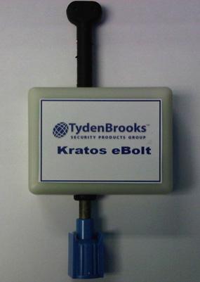
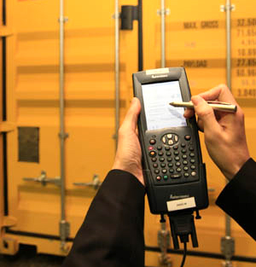
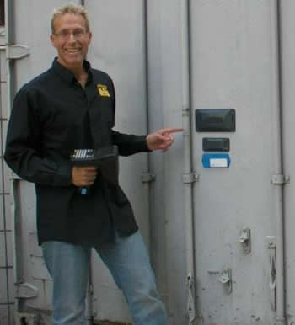
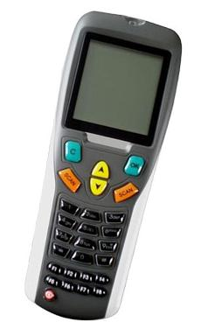
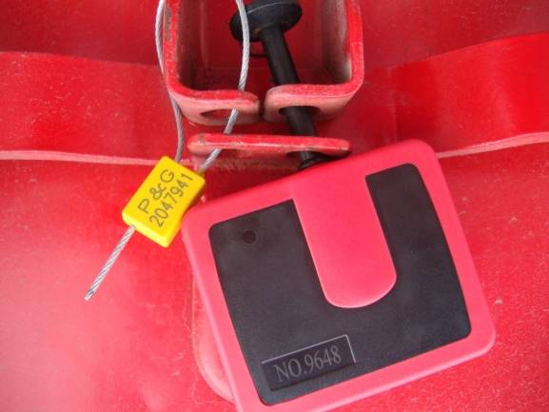
An Electronics Sandbox
Electronic tags, seals, sensors, etc

Slide 34
CTMS – the Newest Initiative
Container Tracking & Monitoring System
Approved work item
Requirements just starting
Multi-year project
Communication Interface
Infrastructure
e.g., reader, satellite, cellular
Device(s)
e.g., CTD
Operator Information Management System

Slide 35
TC104 Subcommittee 4 - Identification & Communication
WG3 = Communications & Terminology
Establishes & maintains all the data elements, messages, etc used to move information. Many changes in other areas cause changes here.

Slide 36
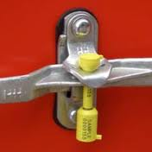
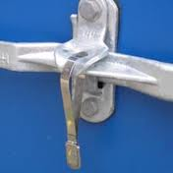
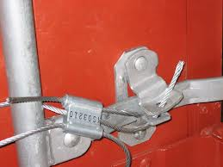
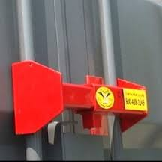
TC104 Working Group 8 - Mechanical Seals
Many kinds
Many different requirements
Bad guys getting smarter
Seals have to keep up
Latest: hi-strength bolt seal

Slide 37
Cooperation With Other Bodies
TC204
TC104
TC122

Slide 38
The Dream of the Logistics World
To the roadside
Container
Long-range radio
Device readers
Electronic seal
δ

Slide 39
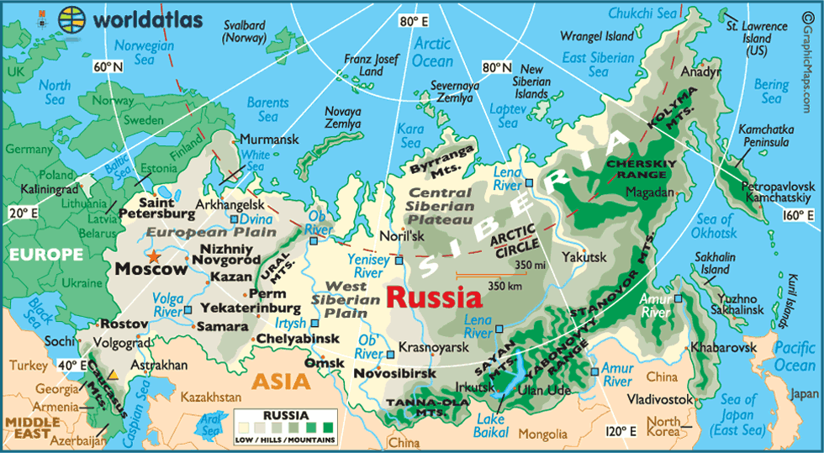
TC204 Initiative
Freight Corridor Management

Slide 40
Another Texas Truism
If you find a turtle on a fencepost, you can be sure he didn’t get there by himself

Slide 41
And TC104 Doesn’t Do It Alone
We have many partners
And BIC has been one of the best!
Let’s keep doing it – together!

Slide 42
Thanks BIC!
And
HAPPY BIRTHDAY!

