Slide 1
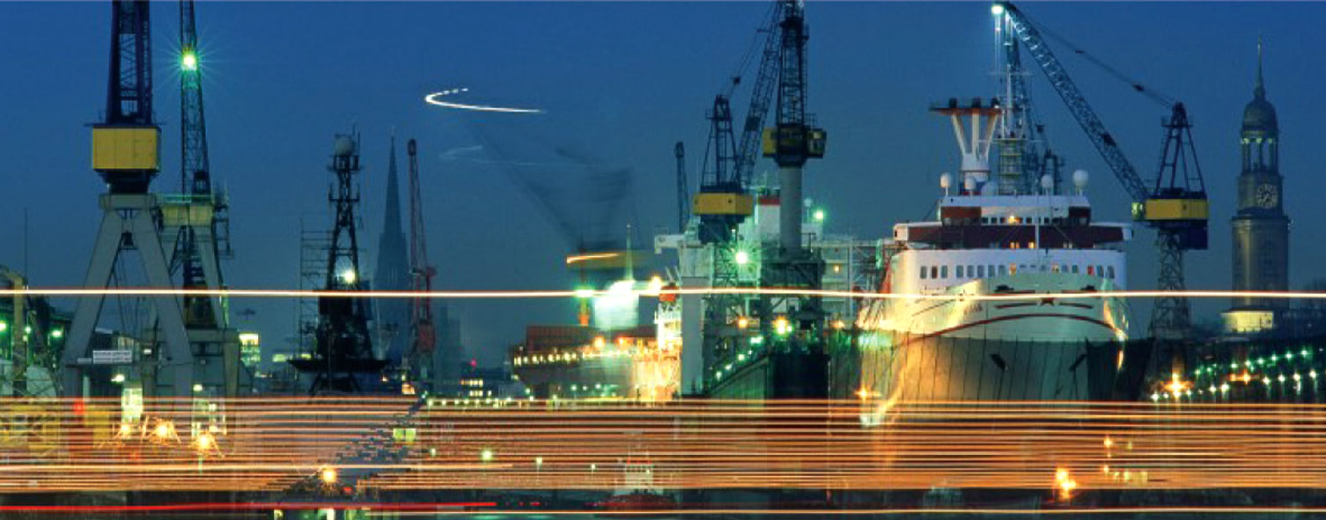





Todays Challenges for transport corridors
The perspective of the Interreg IVC project
PORT Integration
Michael Stange

Slide 2
Agenda
Approach of the Port Integration Project
Success factors of sustainable transport corridords
Strategic options recommended by the Port Integration project
Good Practices of the Port Integration project

Slide 3
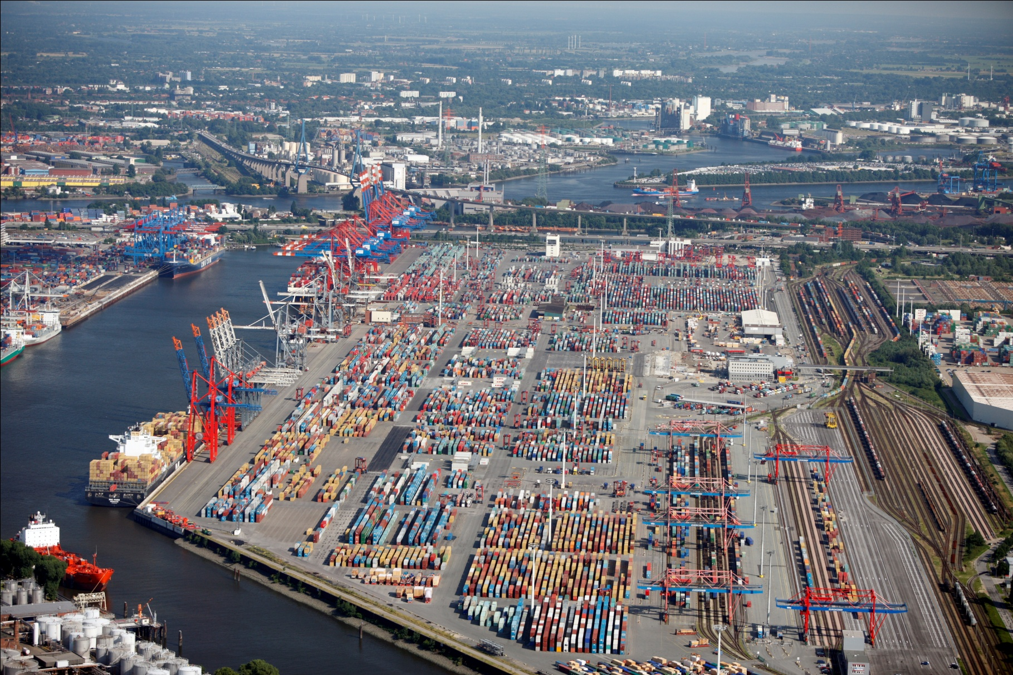
Approach of the Port Integration Project
Port
Ship-pers
Access (Road, Rail)
Econo-my/
Enviro-ment
Govern-ment
Port Integration:
- Identification, exchange and transfer of
Good Practices in the transport sector.
- Concentration on the transport chain
as a whole (incl. maritime/hinterland
transport and combination of relevant
strategies

Slide 4
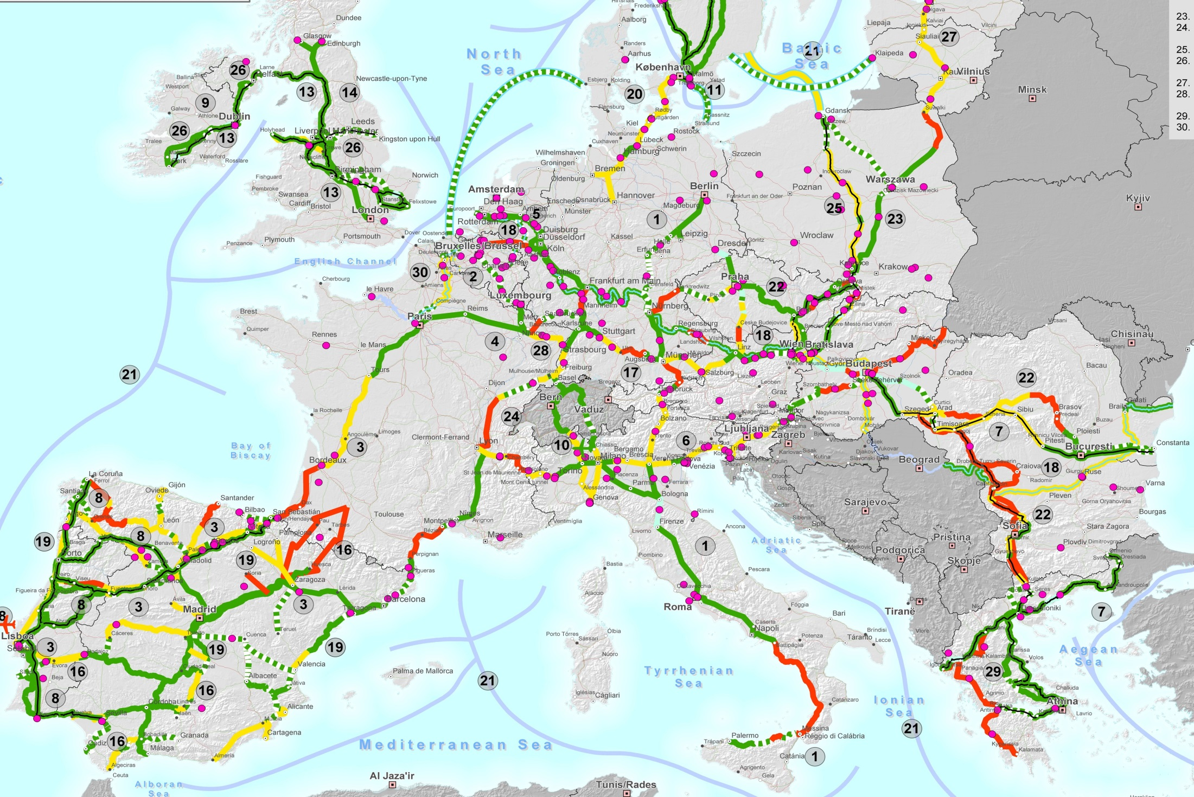
Selected Corridors

Slide 5
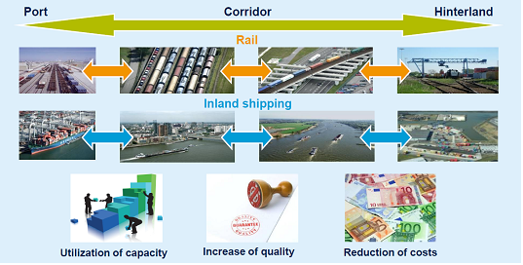
Success factors of sustainable transport corridords
Source: Port of Rotterdam.

Slide 6
Stekeholder Analysis/roadmap of conflicts
Analysis of most important stakeholders in the port and their interests:
Shippers, terminals and industry want cheap, reliable transport, smooth operations and fast turnover in the port
Government and agencies (customs, police, veterinary, police) want reliable controls, belong to different ministries and act under various rules
Analysis of Conflicts:
Administrative obligations versus fast transport
problems of accessability (depth, rail, road, hinterland)
Problems of communication between stakholders and government (ICT)
Lack of communication between relevant actors
Lack of awareness for relevant problems

Slide 7
SWOT-Example IMP
Analysis of current situation of port and hinterland
STRENGTHS = currently strong / positive factors | WEAKNESSES = currently weak / negative factors
Is the port well connected with hinterland and its industry? Use of internationally standardized IT formats? Open port with non-discriminatory access? Support of all modes of transport? Inland terminal integration available? Increase of port efficiency as key objective for all players including administration? | Do Costs/administration create possible entry barriers? Are user fees for operation and maintenance of infrastructure competitive? Is there a high dependency on few players? How weak is the hinterland access (rail/inland waterways?
Volume increases possible? Efficient processes and intelligent modes of transport existing? Adequate benefit-cost ratio? Sustainable logistics solutions available? | Impact from weak market performance? Public funding and economic dependency? Lack of acceptance by relevant players? Good administrative organisation?
OPPORTUNITIES = future strong / positive factors | THREATS = future weak / negative factors
Future (external) Trends

Slide 8
Strategic options for ports
Political „networking“ on supra-regional, nationwide and European level
Strong process and efficiency orientation
Increased thinking across modes of transport and port locations
Openness for activities outside port limits (e.g. hinterland infrastructure participation like in Rotterdam)
Adaption of port authority organisation towards a stronger hinterland commitment (hinterland co-ordinator)
Establishment of relationships to hinterland partners
Strong focus on high efficiency of (hinterland) infrastructure utilization and capacity management
Consideration of new opportunities regarding the project financing (i.e. PPP)
Creation of innovative ways for port regulations and contract design (e.g. modal-split targets)

Slide 9
Good Practices of Port Integration
A
Optimization of the communication between ports and their hinterland by using ICT - Information and Communication Technologies
PC
B
Sustainable strategies for port authorities to influence the use of certain modes of transport and the assortment of dedicated dryports
PA
C
PA
Integration of stakeholders port / hinterland
D
GOV
Optimization of administration processes

Slide 10

Contact
Thank you for your attention.
Please visit our webpage:
http://www.portintegration.eu/
Michael Stange
Free and Hanseatic City of Hamburg
Ministry for Economy, Transport and Innovation
Tel.: +4940 4 28 41 2234
E-mail: Michael.Stange@bwvi.hamburg.de

